Slide 1
Computer graphics and augmented reality
Lecturer : Tanaboon Tongbuasirilai
Course : ICCS404
Week 1 : Introduction to Computer Graphics

Slide 2
Course outline – CG
Computer Graphics topics
Week 1 – Introduction to Computer Graphics
Week 2 – 2D Graphics
Week 3 – OpenGL
Week 4 – 3D Graphics
Week 5 – Transformations
Week 6 – Light and Color

Slide 3
Course outline – XR
Extended Reality (XR) topics
Week 7 – WebGL
Week 8 – Human Visual Perception, Extended Reality (XR)
Week 9 – Augmented Reality (AR) and AR Development
Week10 – AR Experience Design
Week11 – Virtual Reality (VR) and VR Development
Week12 - VR Experience Design

Slide 4
Course materials – CG
Introduction to Computer Graphics by David Eck, Hobart and William Smith Colleges (Open Textbook Library: CC BY-NC-SA). https://math.hws.edu/graphicsbook/index.html
https://www.scratchapixel.com/
Fundamentals of computer graphics by Steve Marschner, Cornell University, Peter Shirley, Purity, LLC ; with Michael Ashikhmin, Michael Gleicher, Naty Hoffman, Garrett Johnson, Tamara Munzner, Erik Reinhard, William B. Thompson, Peter Willemsen, Brian Wyvill, Fourth edition.
Reference URLs in course slides.

Slide 5
Grading
Learning Outcomes | Evaluation Method* |  |  | Weight​ (Percentage)
 | Quiz | Coding Assignment | Project
CLO1 Classify use cases for 2D/3D computer graphics and augmented reality. | 5 | - | - | 5
CLO2 Produce mathematical representation of 2D and 3D objects. | 5 | 10 | 15 | 30
CLO3 Generate and Manipulate 2D and 3D computer graphics. | 5 | 10 | 15 | 30
CLO4 Implement augmented reality applications. | 5 | 10 | 20 | 35
Total | 20 | 30 | 40 | 100

Slide 6
Projects
Project 1 - OpenGL (15) - Tanaboon
Project 2 - WebGL (15) - Pisut
Project 3 - AR (20) - Pisut

Slide 7

A picture is worth a thousand words
How you describe this picture in text …
Notes:
Let students discuss about 5-10 mins

Slide 8
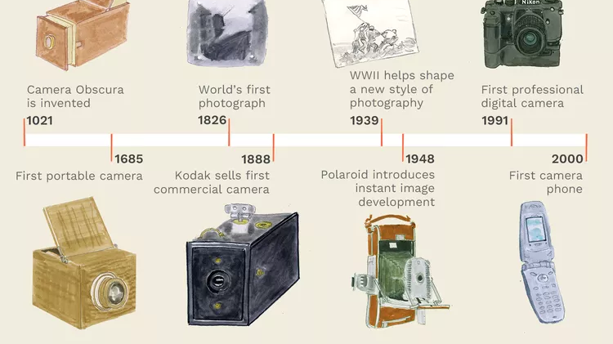
The History of imagery
https://www.sutori.com/en/story/the-history-of-imagery--WBqCQVTzEyER2h6aH4mXgKpc
https://www.thesprucecrafts.com/brief-history-of-photography-2688527

Slide 9
Creativity is beyond … imaging devices.
Ability to create more visual effects rather than to capture from nature or natural phenomenon.
Ability to add more visual contents to enhance experience.
Ability to gain more data insight from other contexts such as text or sound.
Etc…
Notes:
We can capture images, but we need control over them.
That’s when computer graphics is stepping in this realm.

Slide 10

What is computer graphics ?
The process of creating computer generated imagery, from creating digital three-dimensional models, to the process of texturing, rendering, and lighting those models, to the digital display of those renderings on a screen. ---- [https://www.graphics.cornell.edu/about/what-computer-graphics]
Computer graphics is a broad field that encompasses the creation, manipulation, and representation of visual content using computers. It involves generating images, animations, and other visual outputs through the use of algorithms, mathematical models, and computer software.

Slide 11

Why computer graphics ?
Computer graphics are essential for a wide range of applications across many industries.
Visualization
Entertainment
Design and creativity
Simulation
Education
Commercial business – Advertising
Virtual reality (VR) and augmented reality (AR)
Notes:
More discussion on applications.
Cultural heritage
Training
Virtual catalog

Slide 12

Key topics
Rendering – image generation
Material and shape modeling
Animation
Image processing
Computer vision
Extended reality (XR)
Notes:
Talking into details about each topic.

Slide 13
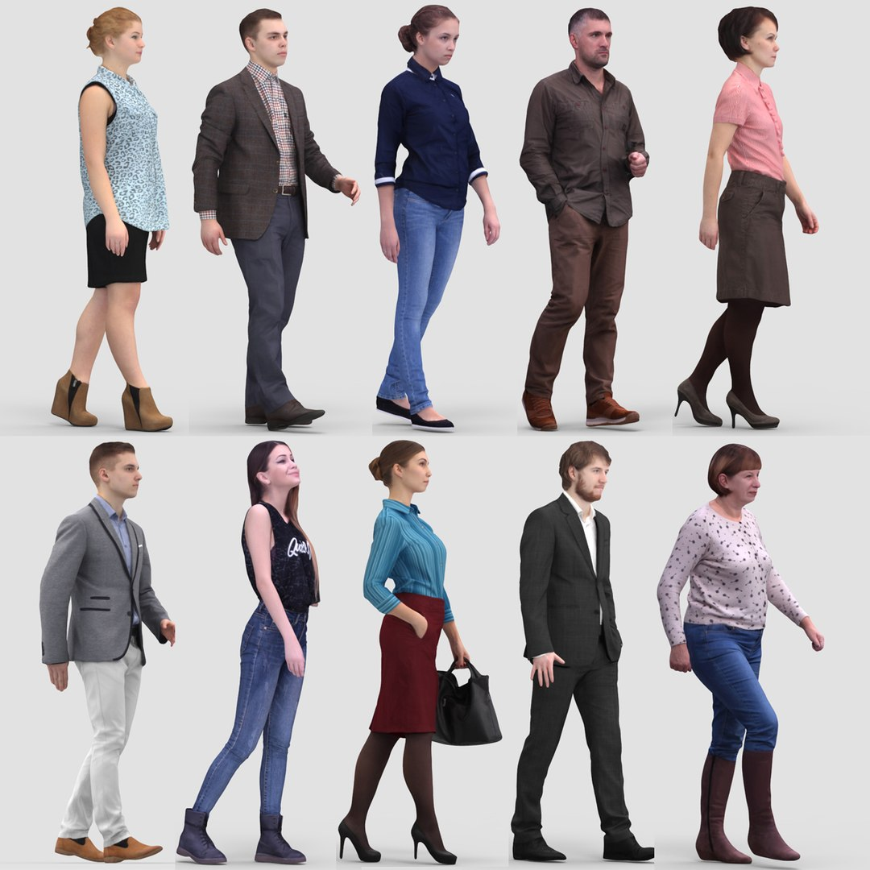
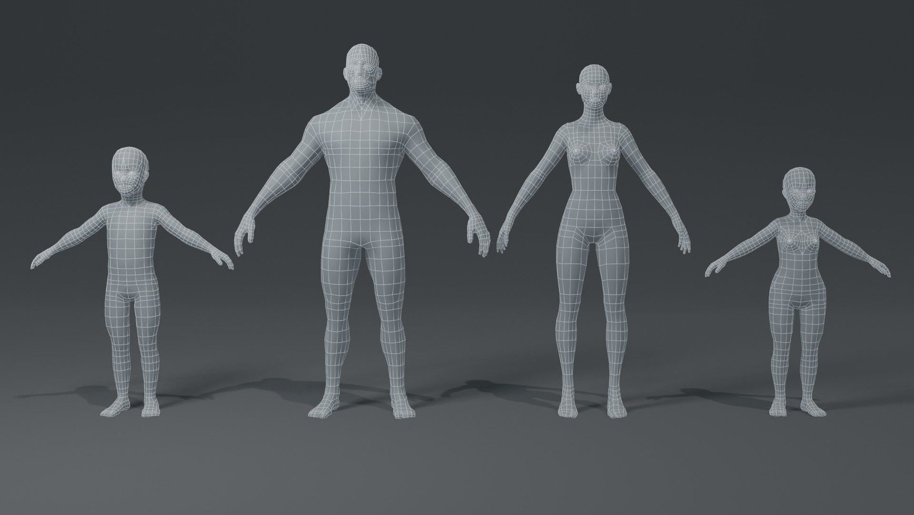
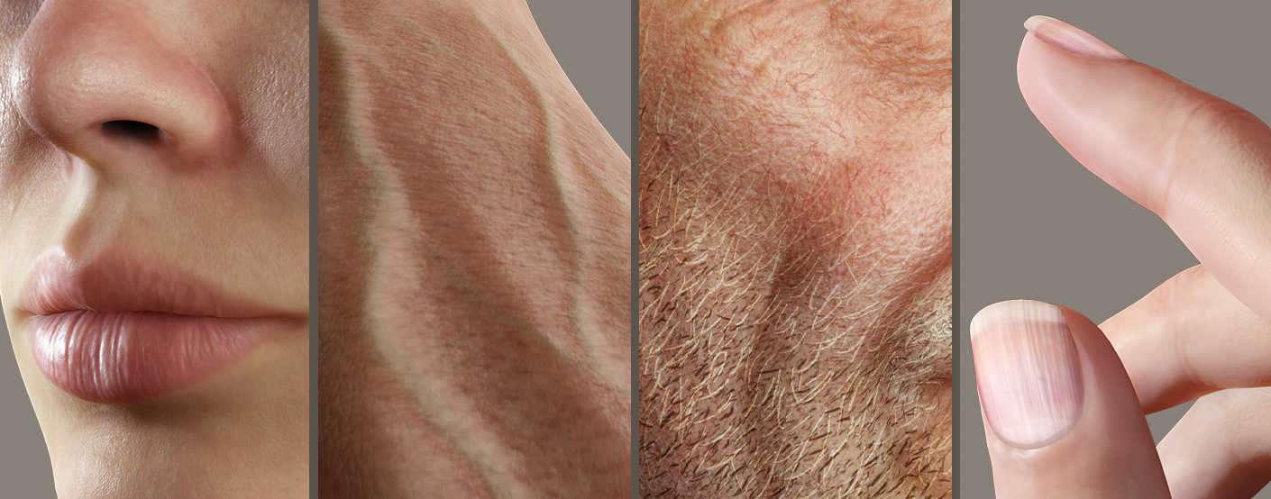
Pipeline for 3D graphics
3D modeling
Appearance modeling
Rendering
- Points, Vertices
- Edges
- Meshes
- Reflectance modeling
- Texture generation
- Photo-realistic rendering
- Non photo-realistic rendering

Slide 14
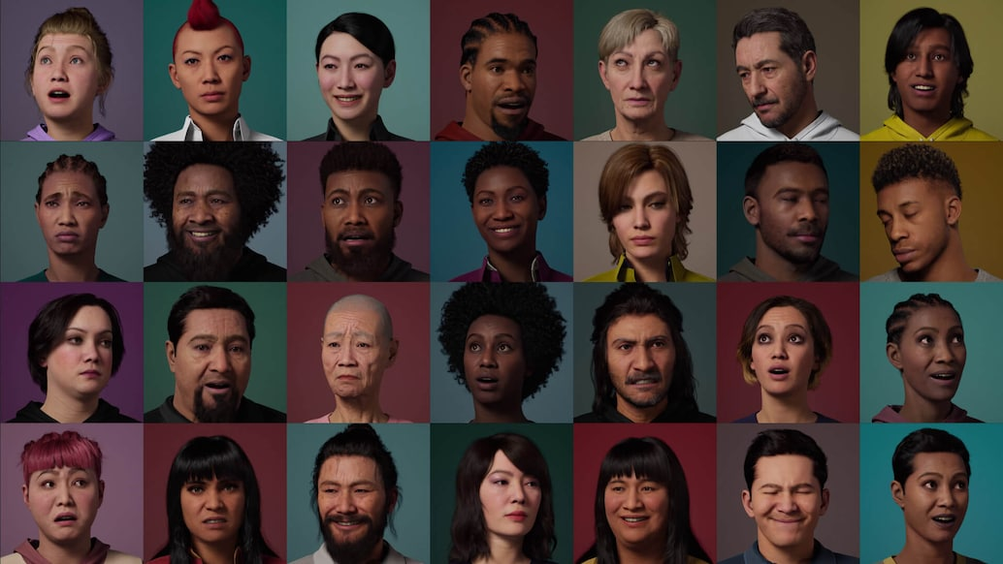


Applications
Digital humans
Automotive industry
Virtual furniture catalog
https://www.unrealengine.com/en-US/metahuman
https://www.chaos.com/gallery/taylor-james-ford-ranger
https://virtualstaging.foliowebsites.com/album/dining-rooms

Slide 15
Entertainment industry - Major components related to computer graphics (CG)
Filmmaker – demanding - Filmmaking is the overall process of creating a movie, from the initial idea to the final cut. It encompasses everything - scriptwriting, directing, acting, cinematography, editing, and of course, the visual effects we're talking about.
Special effect (SFX) – early development - These are the physical effects created during filming on set. Think explosions, pyrotechnics, animatronics (those cool robots!), makeup for fantastical creatures, or even controlled rain and fog machines. SFX artists are the magicians on set, making things happen live.
Visual effect (VFX) – efficient and effective tools - VFX come into play in post-production, after filming is complete. Here's where computer graphics (CG) takes center stage. VFX artists use software to create things that can't be filmed in real life - dragons soaring through the sky, futuristic cities, or even making actors appear younger. They can also enhance what was filmed, adding things like muzzle flashes to gunfire or erasing unwanted objects from the scene.
Digital production – editing tools - This is a broad term that encompasses all the digital tools and techniques used in filmmaking, including both SFX and VFX. It could involve using green screens to film actors in front of a digital background that will be added later, or using digital editing software to put all the pieces together.
https://www.adobe.com/creativecloud/video/discover/a-guide-to-special-effects-in-movies.html
Notes:
Specific topic – CG is applied in this area where people can be perceived and exposed a lot.

Slide 16
Special Effects in Movies: The role of computer graphics
Origins and History: Special effects (SFX) and visual effects (VFX) have evolved from early camera tricks by pioneers like Georges Méliès to modern digital techniques.
Differences: SFX are practical effects created on set (e.g., explosions), while VFX are created in post-production using CGI and animation.
Examples: Early films used stop-motion and prosthetics, while modern films like "Jurassic Park" and "Avatar" use a blend of animatronics and CGI.
Tools and Techniques: Computer graphics are essential for editing and creating VFX, enabling filmmakers to realize complex visual narratives.

Slide 17
Working domain of computer graphics
Human Visual System perceives 3D world in a form of 2D representation.
Computer graphics work in hybrid with 2D and 3D representations, e.g., images and 3D objects.
Textures are essentially 2D images (photos, illustrations, etc.) that are mapped onto the surface of a 3D model to provide details and visual complexity.
Billboards (flat planes with images), particle effects (like sparks or smoke), and even traditionally animated characters can be integrated into a 3D scene. This allows for creative freedom and efficient rendering of specific elements. Imagine a cartoon spaceship flying through a meticulously crafted 3D cityscape.
2.5D graphics is a term used to describe a visual style that creates the illusion of a 3D space using primarily 2D elements. It essentially sits between 2D and 3D graphics.

Slide 18
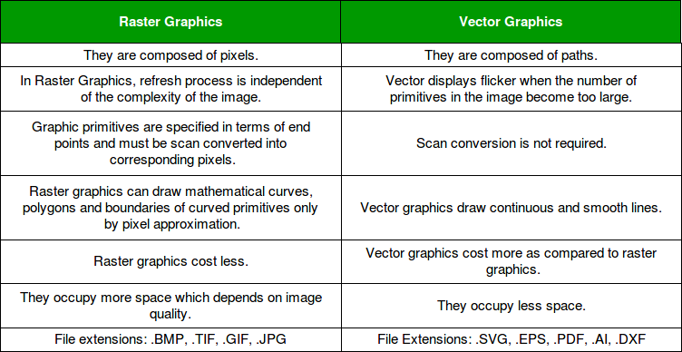
How to represent images on a display ?
Computers can store and represent images in two fundamentally different ways: using tiny squares called pixels (raster graphics) or using mathematical formulas to define shapes (vector graphics).
https://www.geeksforgeeks.org/vector-vs-raster-graphics/

Slide 19
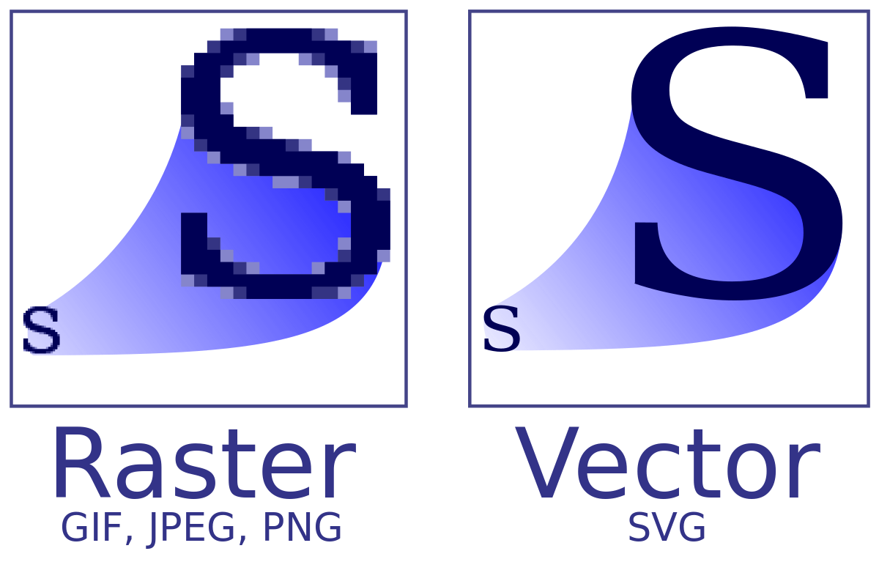
An Example
What are Vector Graphics? (youtube.com)

Slide 20
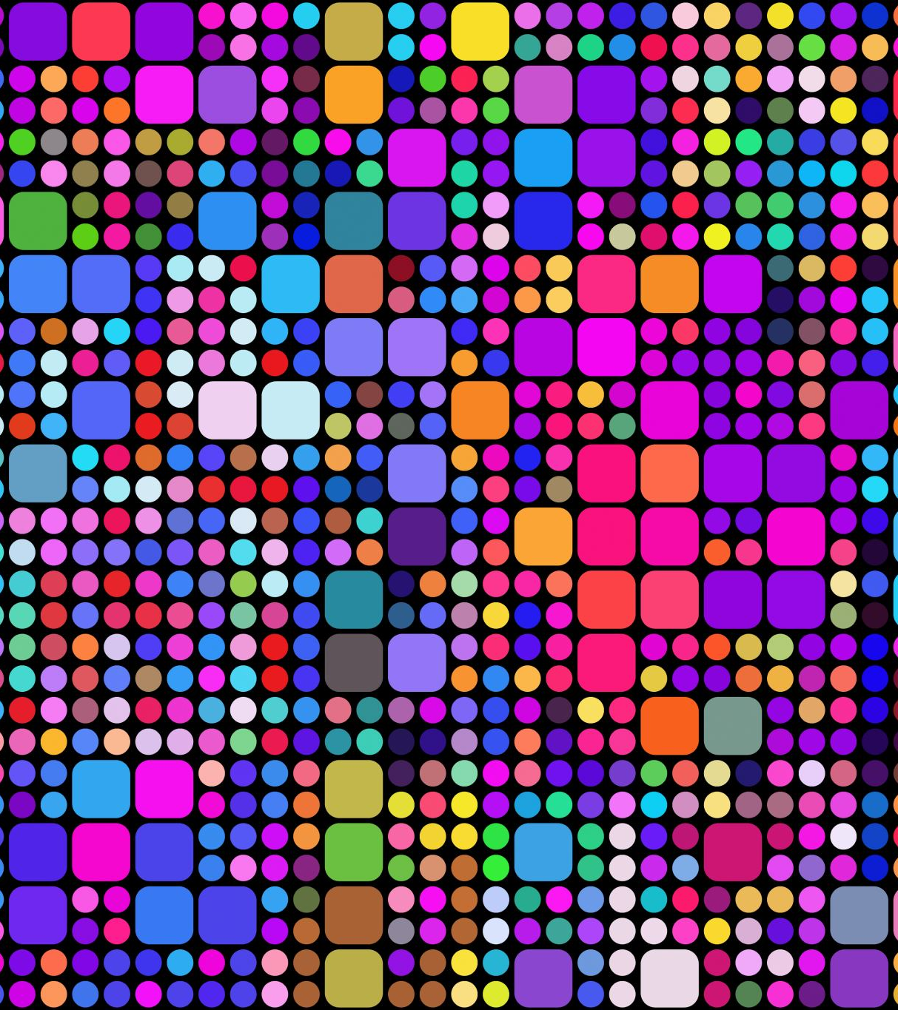
Raster images
Raster Displays - Most computer graphics are shown on raster displays, which present images as rectangular arrays of pixels. Examples include flat-panel displays and televisions.
Color Creation -Different colors are created by mixing varying intensities of red, green, and blue light.
Raster Devices - Printers like laser and ink-jet printers are also raster devices, creating images by depositing ink at selected points on a grid.
Input Devices - Devices like digital cameras and scanners use rasters to capture images. They contain grids of pixels that record color and light intensity.
Raster Images - Due to the prevalence of raster devices, raster images (2D arrays of pixels) are the most common way to store and process images. These images store pixel values, typically as three numbers representing red, green, and blue, and can be displayed by controlling the color of each pixel on a screen.
Notes:
How raster graphics are used in daily life ?

Slide 21
Raster and Vector Images
Image Display Flexibility - Images may need resizing, reorienting, color correction, or display on 3D surfaces, which breaks the direct link between image pixels and display pixels.
Device Independence - A raster image should be seen as a device-independent description, with the display device approximating the ideal image.
Vector Images - Unlike raster images, vector images describe shapes and colors without reference to a pixel grid. They store instructions for displaying the image, making them resolution-independent and ideal for high-resolution displays.
Vector Image Applications - Vector images are commonly used for text, diagrams, and mechanical drawings where crispness and precision are key, though they must be rasterized for display and are less suitable for photographic images or complex shading.

Slide 22
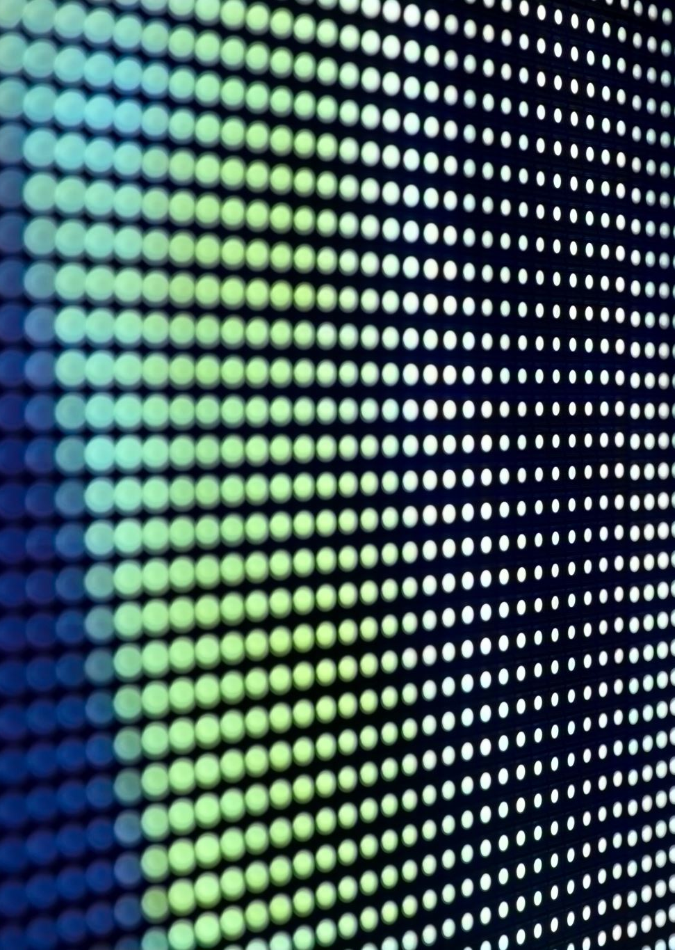
Types of Displays
Current displays, including televisions, projectors, and computer screens, are based on fixed arrays of pixels and can be categorized into emissive and transmissive displays.
Emissive Displays
These displays, like LED screens, emit light directly. Each pixel contains LEDs that emit light based on the electrical current. In color displays, each pixel has three subpixels (red, green, and blue), which combine to create different colors.
Transmissive Displays
Examples include LCDs, which do not emit light but control the amount of light passing through. They require a light source, such as a backlight in monitors or a lamp in projectors. The liquid crystal in each pixel rotates the light's polarization to control its intensity.
Color Subpixels
Both LED and LCD displays have red, green, and blue subpixels within each pixel, which combine to produce the final perceived color when viewed from a distance.
Fixed Resolution
Displays with a fixed pixel grid have a resolution determined by the grid's size (e.g., 1920 × 1200 pixels). Images of different resolutions must be converted to match the display's resolution.

Slide 23
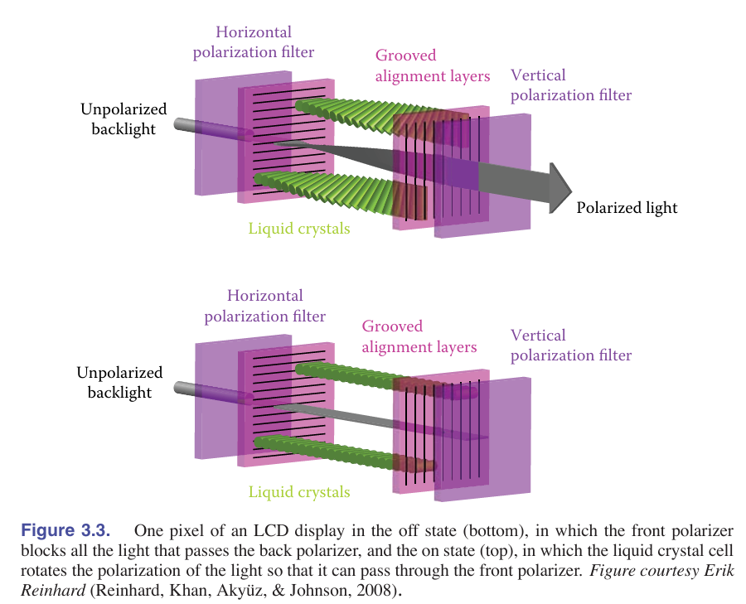
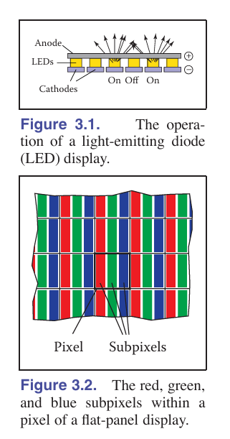
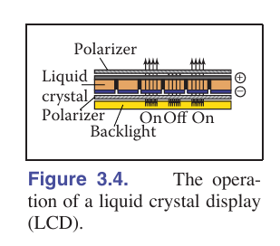
Fundamental of Computer Graphics, forth edition

Slide 24

Input device
Raster images originate from raster input devices like cameras and scanners, which measure light for each pixel using arrays of sensors.
Digital Cameras
Cameras use 2D arrays of light-sensitive pixels, such as CCD (Charge-Coupled Devices) or CMOS (Complementary Metal-Oxide-Semiconductor) sensors. These sensors measure light energy at each pixel, producing a number that forms the output image.
Color Measurement in Cameras
Most cameras use a color-filter array (mosaic) where each pixel only captures red, green, or blue light. The missing color data is filled in through a process called de-mosaicking. Some cameras use three separate arrays or layers to measure red, green, and blue at each pixel, capturing more detailed color information.
Camera Resolution
The resolution of a camera is determined by the number of pixels in its sensor array. A camera with a 3000 × 2000 pixel array is a 6-megapixel camera. Cameras with independent color measurements capture more information than those using a mosaic sensor.
Flatbed Scanners
Scanners use a 1D array that sweeps across the page, measuring red, green, and blue values at each grid point. The resolution across the page is fixed by the array size, while the resolution along the page is determined by the measurement frequency. Scanner resolution is typically reported in pixels per inch (ppi).

Slide 25
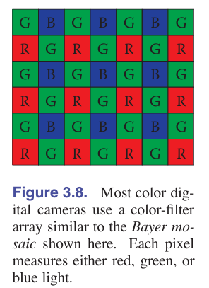
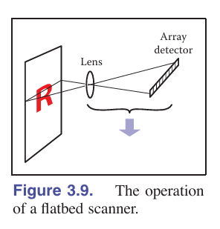

Slide 26
Bayer mosacing pattern
The human eye is more sensitive to green light. This sensitivity stems from the way our eyes are structured, with a higher concentration of green-sensitive photoreceptor cells (cones) compared to those sensitive to red or blue light.
Key reasons for the 2:1:1 green-red-blue ratio
Human Vision Sensitivity: Our eyes perceive brightness primarily through green light. By doubling the number of green pixels, the Bayer pattern enhances the perceived sharpness and detail of the image.
Improved Luminance Resolution: Green contributes more to the luminance (brightness) of an image than red or blue. The increased number of green pixels allows the image sensor to capture finer details, leading to better overall image quality.
Balanced Color Reproduction: While green is dominant, having fewer red and blue pixels still allows the sensor to capture color information effectively. The image processing software (through demosaicking) interpolates the missing color data, creating a full-color image with a balanced and accurate color representation.

Slide 27
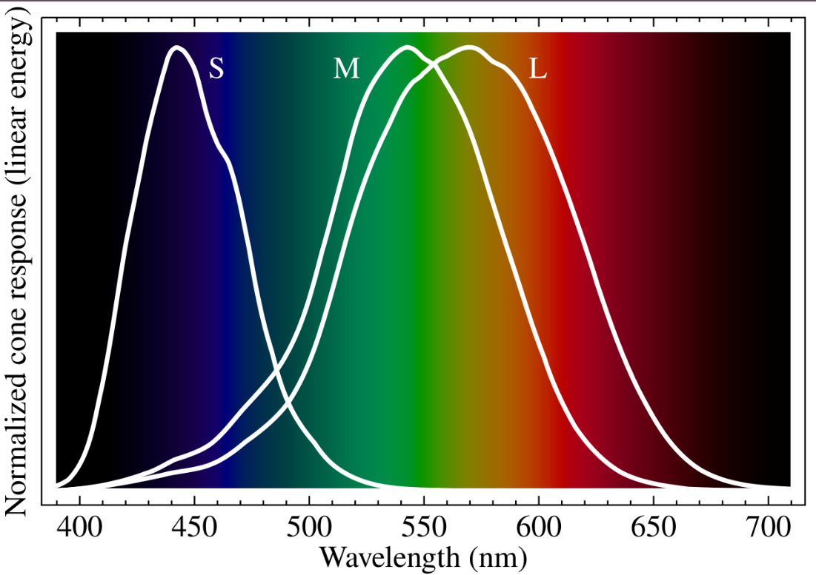

Slide 28

Pixel
Pixels are often described using real numbers representing intensity, which suggests storing images as arrays of floating-point numbers (e.g., one for grayscale or three for RGB color images).
Floating-Point Storage - While storing images in this format provides high precision and a wide range of values, it is memory-intensive. A 10-megapixel image would require about 115 MB of RAM in this format.
Due to memory and bandwidth constraints, less precision is typically used for images meant for direct display. Most devices have a finite maximum intensity, so pixel values are often stored within a bounded range, such as [0,1].
In an 8-bit image, pixel values are stored as integers within a fixed range (e.g., 0 to 255). This is sufficient for many display purposes and is more efficient in terms of storage.
HDR vs. LDR Images - Images stored with floating-point numbers, allowing a wide range of values, are known as high dynamic range (HDR) images. In contrast, low dynamic range (LDR) images are stored with fixed-range integers.

Slide 29
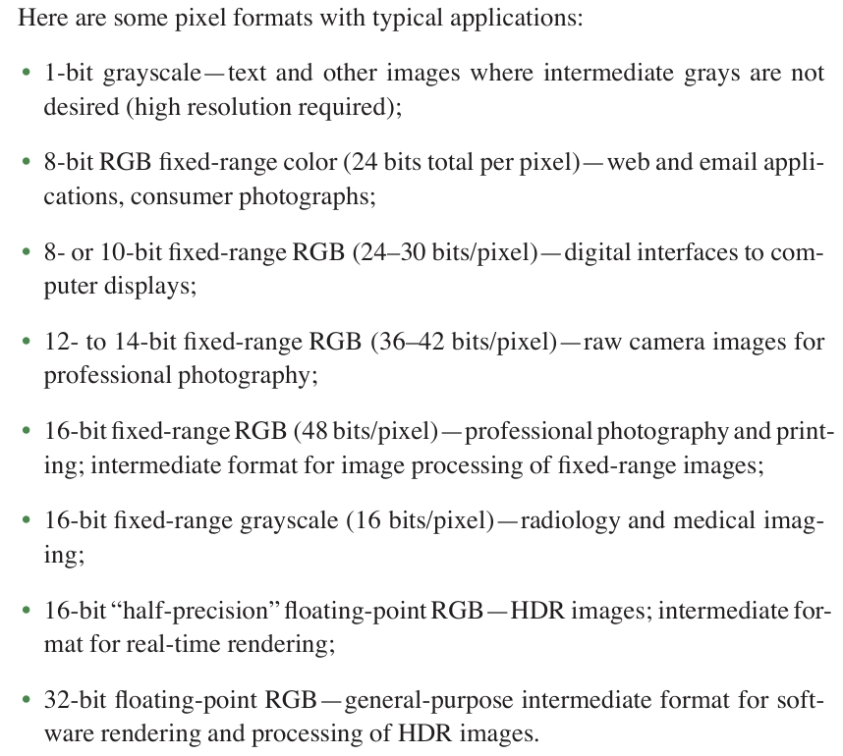
Image formats

Slide 30
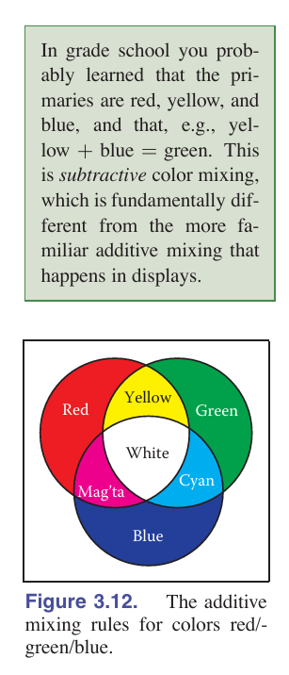
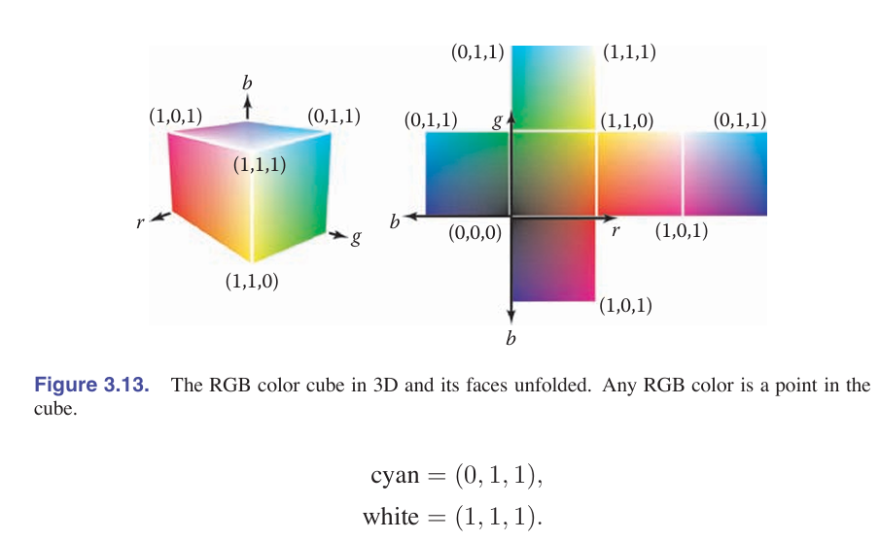
Color models
Notes:
we can create all the colors that can be displayed on an RGB monitor.
The red, green, and blue pixel values create a three-dimensional RGB color cube that has a red, a green, and a blue axis.

Slide 31
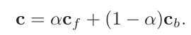
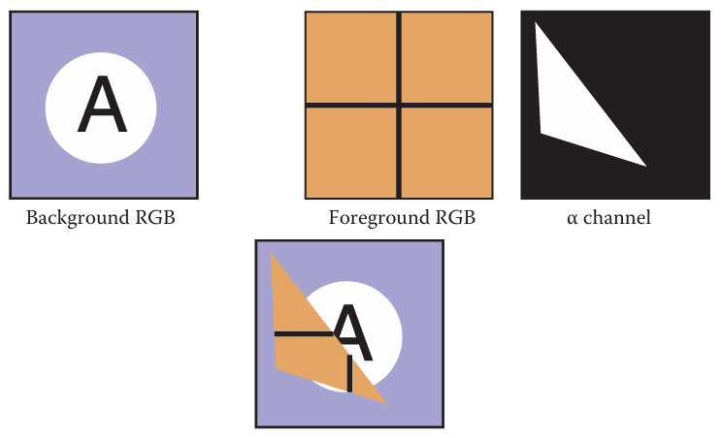
Alpha compositing
For opaque pixels in the foreground, we just replace the background pixel.
For entirely transparent foreground pixels, we do not change the background pixel.
For partially transparent pixels, some care must be taken. Partially transparent pixels can occur when the foreground object has partially transparent regions, such as glass.
But, the most frequent case where foreground and background must be blended is when the foreground object only partly covers the pixel, either at the edge of the foreground object, or when there are sub-pixel holes such as between the leaves of a distant tree.
The α values for all the pixels in an image might be stored in a separate grayscale image, which is then known as an alpha mask or transparency mask. Or the information can be stored as a fourth channel in an RGB image, in which case it is called the alpha channel, and the image can be called an RGBA image. With 8-bit images, each pixel then takes up 32 bits, which is a conveniently sized chunk in many computer architectures.

Slide 32
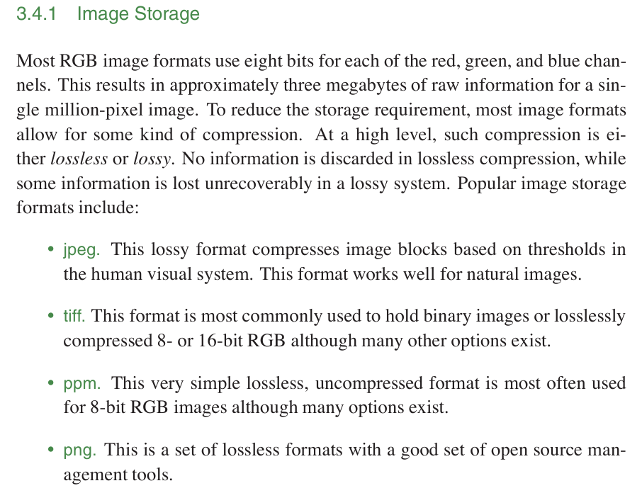

Slide 33
Revisiting the traditional pipeline
Object (Shape) modelling
Appearance modelling
Rendering

Slide 34
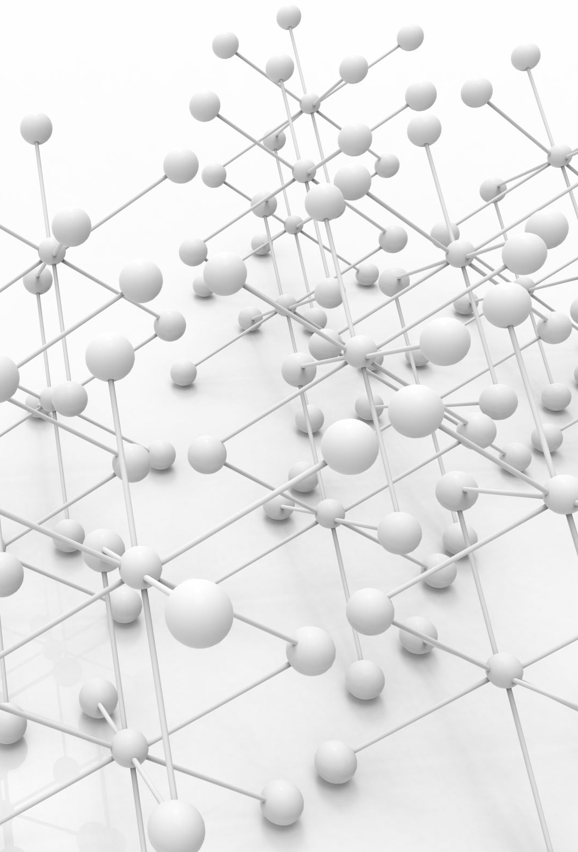
geometry
A coordinate system is used to define how data points are associated and operated.
In 2D graphics, a pair of values (x, y) describes a point of 2D objects, embedded in a 2D space which will be drawn as an image.
Mathematical formulations can be used to create 2D objects such as lines, circles, and triangles.
Explicit representations, on the other hands, construct 2D objects by connecting points.
In 3D graphics, a tuple consisting of (x, y, z) defines a point of 3D objects embedded in a 3D space.
Creating a 3D shape explicitly requires a set of points and edges.
Points constitute the fundamental building blocks for specifying the geometric location of 3D objects.
Edges build up surfaces from connected points. If a set of points are defined with different set of edges, we will obtain different shapes of the object.

Slide 35

Learn more about geometry, 2D graphics and 3D graphics in week 2 – 4.

Slide 36
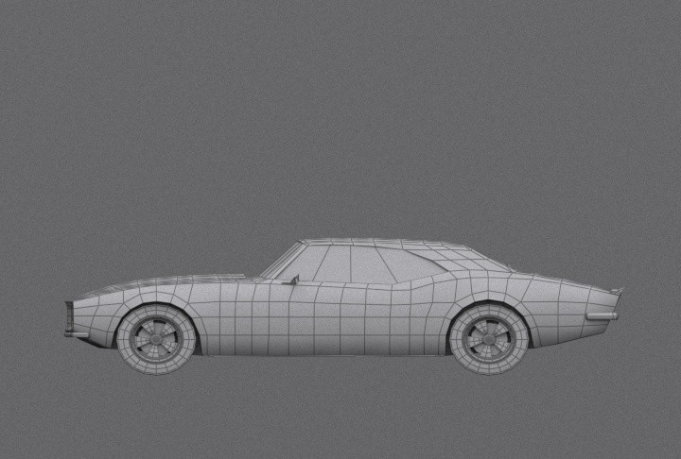
Object manipulation
Supposed that we create a 3D car. The car can be modeled with triangles and spheres. (These basic shapes are called primitives.)
The illusion of a moving car in computer graphics can be achieved through a combination of geometric transformations: translation to simulate linear movement, rotation for animating wheel spin, and scaling to depict variations in car size.
In computer graphics, objects and scenes exist within a virtual world. To precisely manipulate and position these elements, we rely on multiple coordinate systems. There are three key coordinate systems that work together seamlessly. These systems are defined as world space, object space and camera space. Effectively manipulating objects requires understanding the transformations that bridge these spaces.
Week 5 : Transformation

Slide 37
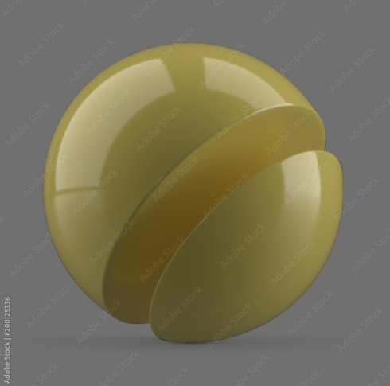
appearance
Human visual system classifies objects based on their appearance.
The interaction of light with an object's physical characteristics determines the specific wavelengths of light reflected to our eyes, resulting in our perception of color.
Color – the simplest term defining how an object looks like.
Material – a more sophisticated term describing the visual appearance of surfaces.
Plastics, metals, paints, matte are some examples of materials typically used in our daily life.
Each material has its own intrinsic physical properties. It means that light interacts differently on different kinds of surfaces.
The physical properties of each surface can be modelled analytically or empirically.
Texture – a special type of materials which each point of its surface is not homogeneous (varying between locations). This material is commonly used in computer graphics applications.

Slide 38

Shading model
Representing materials can be done using shading model.
Shading model is used to compute the intensities and colors to display the surface.
The shading model has two primary ingredients:
properties of the surface
properties of the illumination falling on it.
The principal surface property is its reflectance, which determines how much of the incident light is reflected. If a surface has different reflectance for the light of different wavelengths, it will appear to be colored.
Week 6 : Light and color
https://www.javatpoint.com/computer-graphics-introduction-of-shading

Slide 39
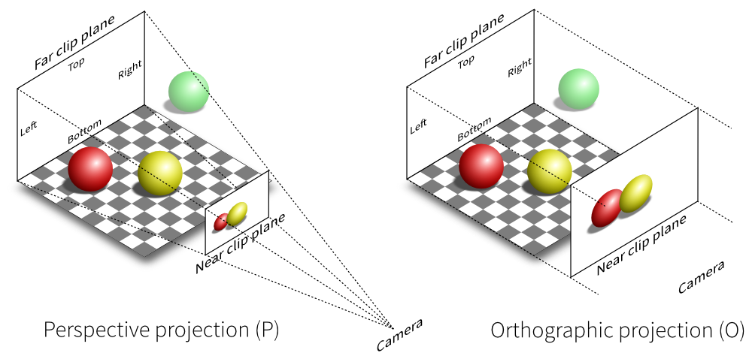
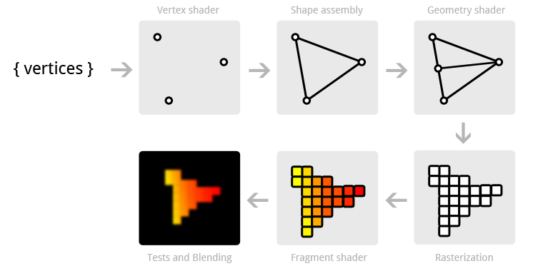
image – the output
Viewing: 3D graphics begin with the creation of mathematical representations of objects (modeling) and defining a virtual camera position and orientation (viewing) to establish the desired perspective.
Projection: The 3D scene is then projected onto a 2D plane, similar to capturing an image with a camera. This transformation accounts for the viewer's position and the final image dimensions.
Rasterization and Rendering: Individual pixels in the 2D image are assigned colors through a process called rasterization. The collective application of modeling, viewing, projection, and rasterization is referred to as rendering, resulting in the final 2D image.
https://glumpy.readthedocs.io/en/latest/tutorial/cube-ugly.html
https://open.gl/drawing

Slide 40
Fundamentals of Animation in 3D Graphics
Sequential Rendering for Animation
Dynamic Scene Elements
Viewpoint Control for Movement Simulation
Physics Engine Integration (Advanced Topic):
Notes:
Sequential Rendering for Animation: The creation of animations involves rendering a sequence of images, each depicting slight modifications to the scene compared to the previous frame.
Dynamic Scene Elements: Animations allow for variations in various scene components throughout the sequence. These controllable aspects include object positioning, application of transformations (like scaling for growth effects), adjustments to material properties, and manipulation of the viewing perspective.
Viewpoint Control for Movement Simulation: Strategic changes in viewpoint during animation can create the illusion of movement or flight through the 3D environment.
Physics Engine Integration (Advanced Topic): For intricate animations, physics engines can be employed to realistically compute object motion and interactions by simulating real-world physics. (This text excludes further exploration of physics engines.)

Slide 41

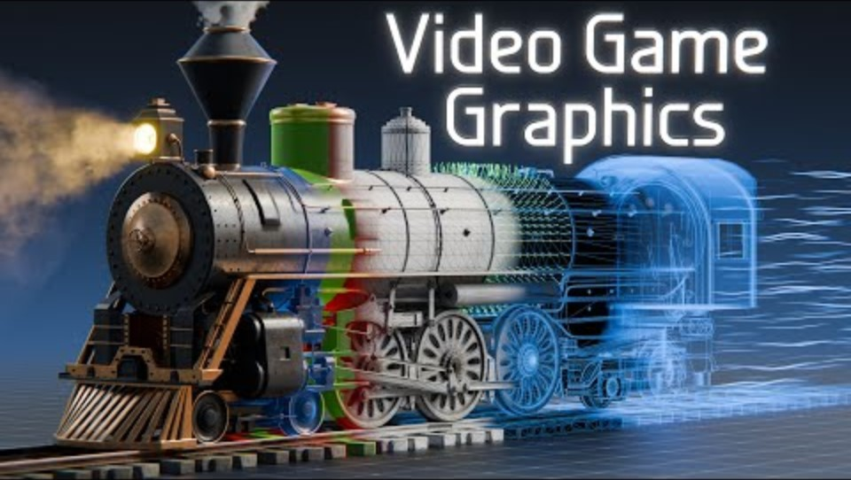
How do video game graphics work?
https://www.youtube.com/watch?v=C8YtdC8mxTU

